Slide 1


Attrition Case Study Zachary Harris

Slide 2
Project analysis slide 2
Overview
7
1
Conclusion
Overview
Attrition Case Study
6
2
Predicting
Insights and Discoveries
5
4
Modeling
Classifying

Slide 3
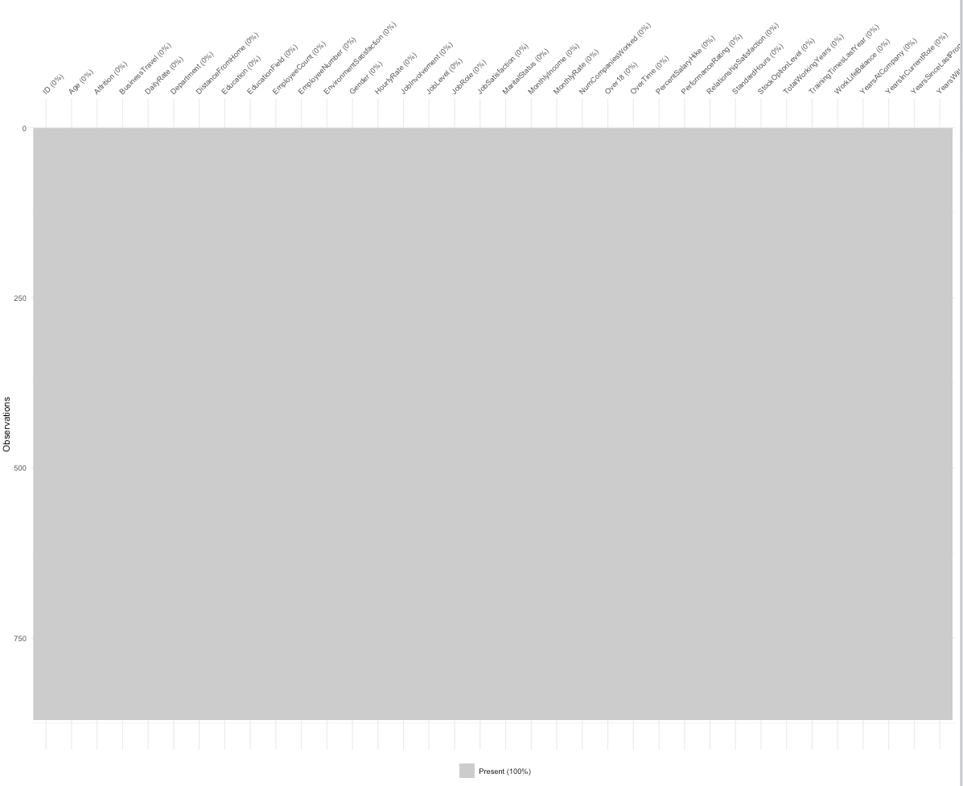
Project analysis slide 3
Insights and Discoveries
Preparing the Data
Summary of Data
Number of Observations | 870
Number of Variables | 36
Missing Values | 0

Slide 4
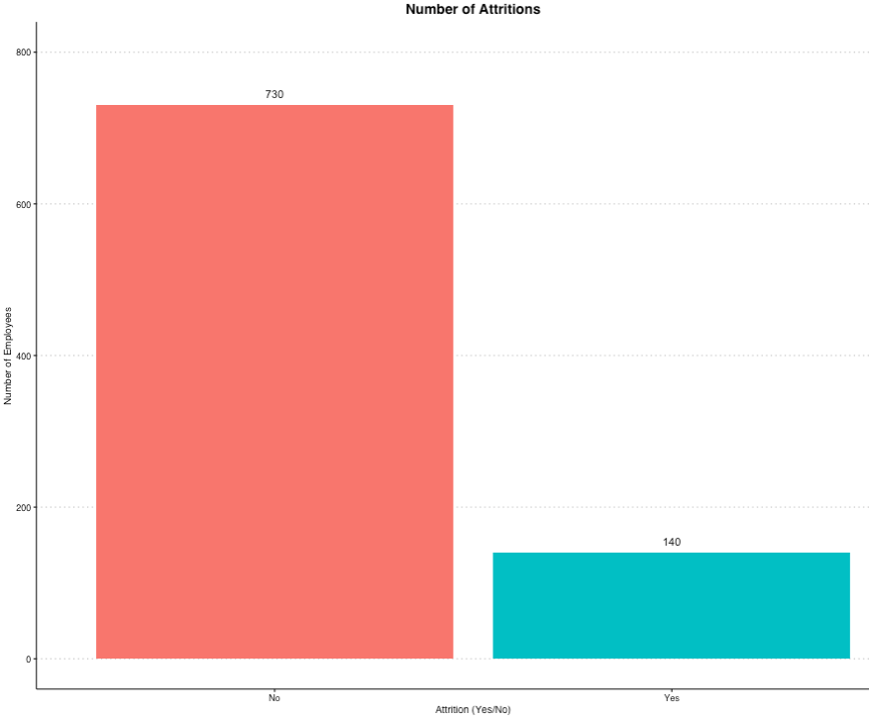
Project analysis slide 3
Insights and Discoveries
Examining the Data
Summary of Data
Number of Observations | 870
Attrition - Yes | 140
Attrition - No | 730

Slide 5
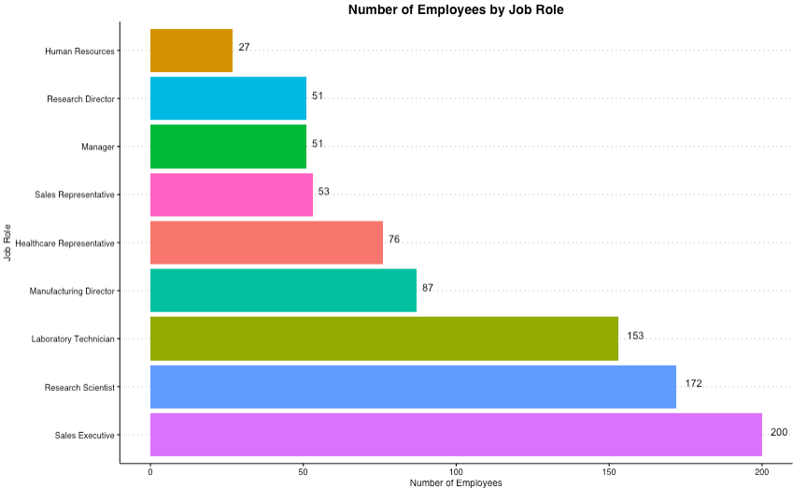
Project analysis slide 3
Insights and Discoveries
Examining the Data

Slide 6
Project analysis slide 3
Insights and Discoveries
Examining the Data

Slide 7
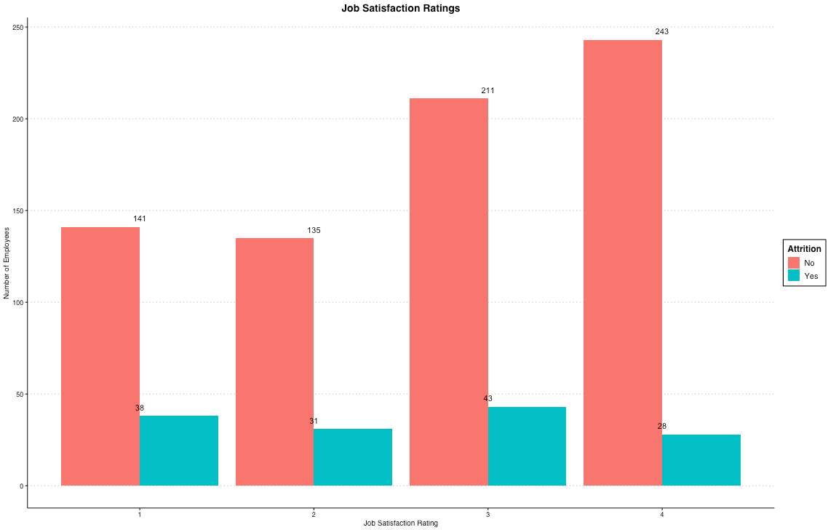
Insights and Discoveries
Examining the Data
Attrition Rate
Rating | Yes | No | Rate
1 | 38 | 141 | .2695
2 | 31 | 135 | .2296
3 | 43 | 211 | .2038
4 | 28 | 243 | .1152

Slide 8
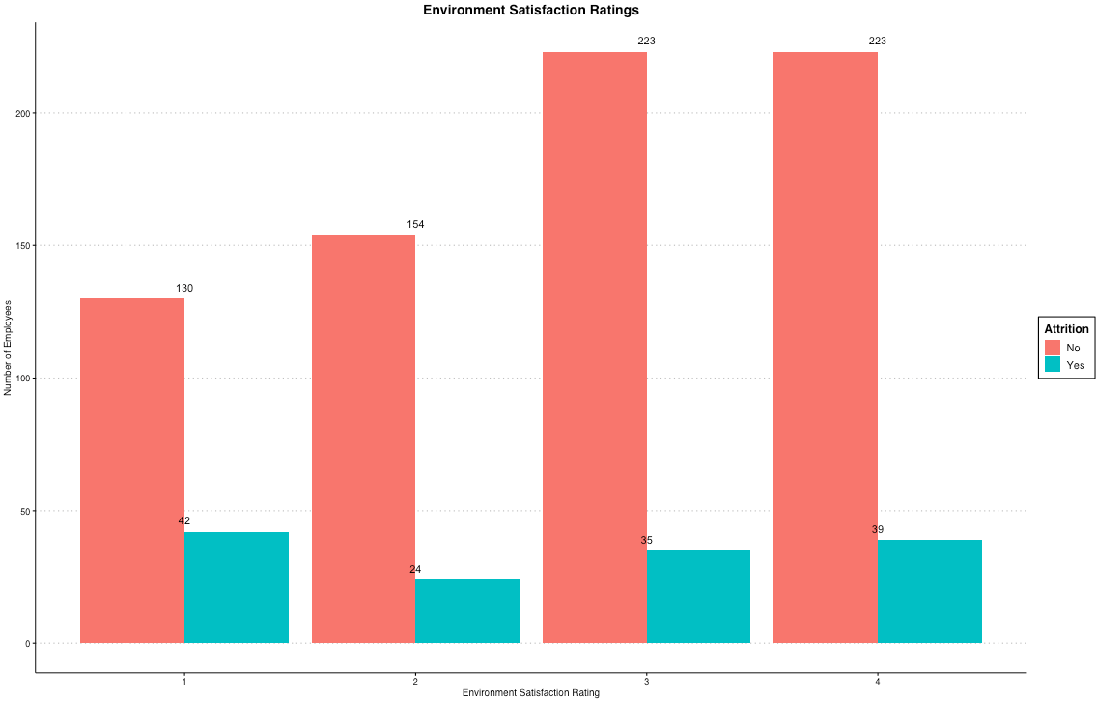
Insights and Discoveries
Examining the Data
Attrition Rate
Rating | Yes | No | Rate
1 | 42 | 130 | .3231
2 | 24 | 154 | .1558
3 | 35 | 223 | .1570
4 | 39 | 223 | .1749

Slide 9
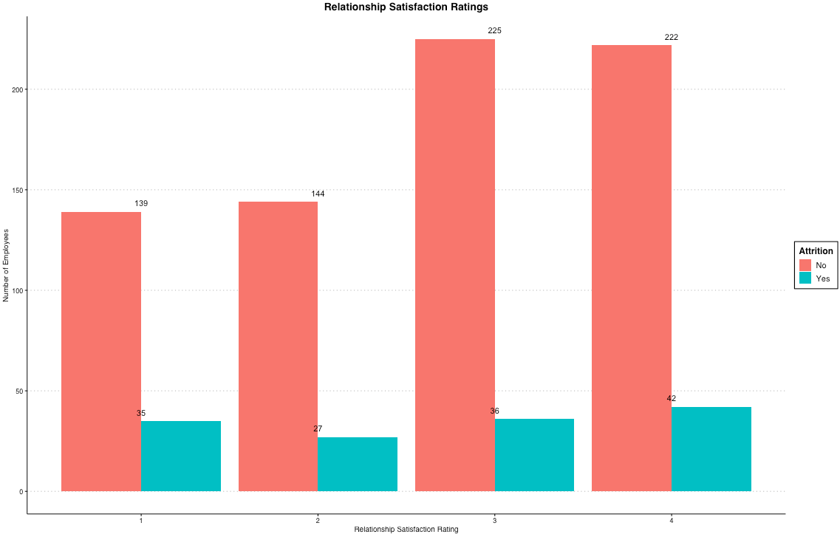
Insights and Discoveries
Examining the Data
Attrition Rate
Rating | Yes | No | Rate
1 | 35 | 139 | .2518
2 | 27 | 144 | .1875
3 | 36 | 225 | .1600
4 | 42 | 222 | .1892

Slide 10
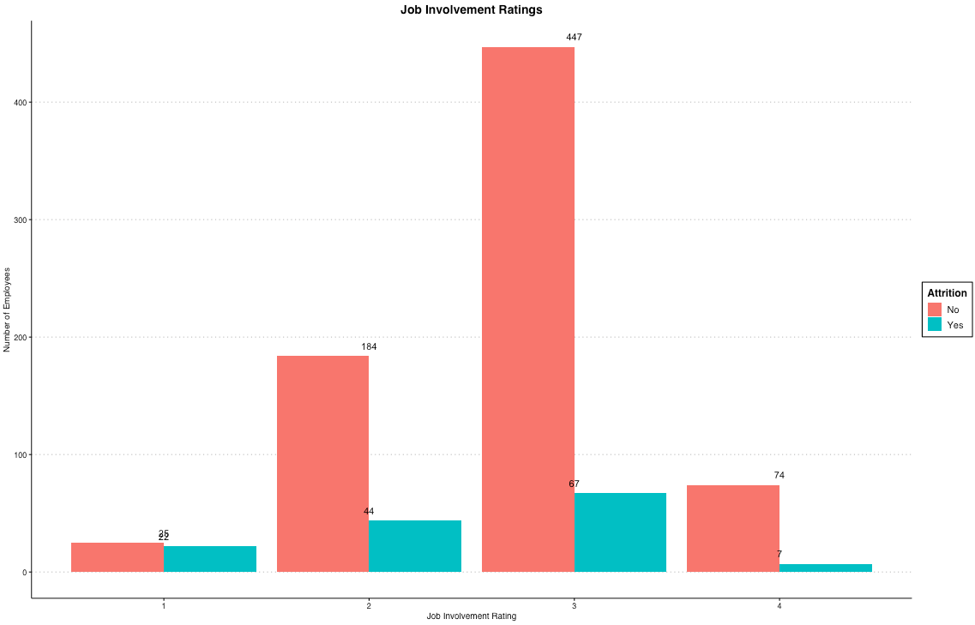
Insights and Discoveries
Examining the Data
Attrition Rate
Rating | Yes | No | Rate
1 | 22 | 25 | .8800
2 | 44 | 184 | .2391
3 | 67 | 447 | .1499
4 | 7 | 74 | .0946

Slide 11
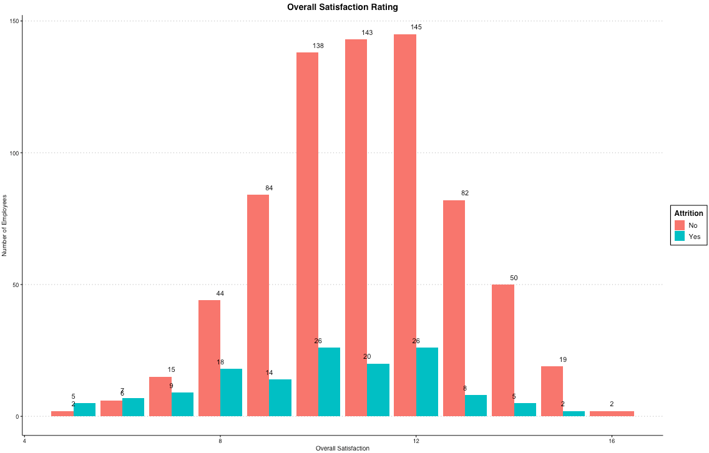
Insights and Discoveries
Examining the Data

Slide 12
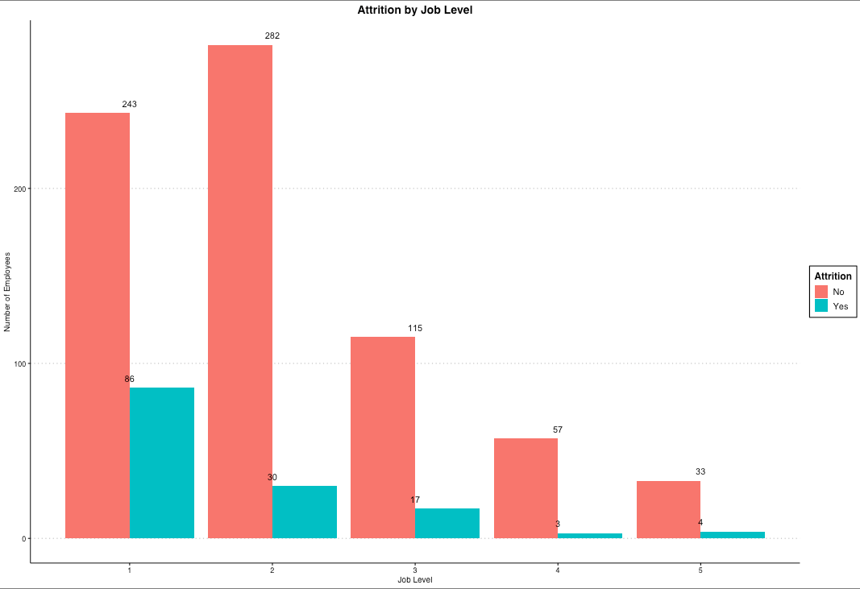
Insights and Discoveries
Examining the Data
Attrition Rate
Level | Yes | No | Rate
1 | 86 | 243 | .3539
2 | 30 | 282 | .1064
3 | 17 | 115 | .1478
4 | 3 | 57 | .0526
5 | 4 | 33 | .1212

Slide 13
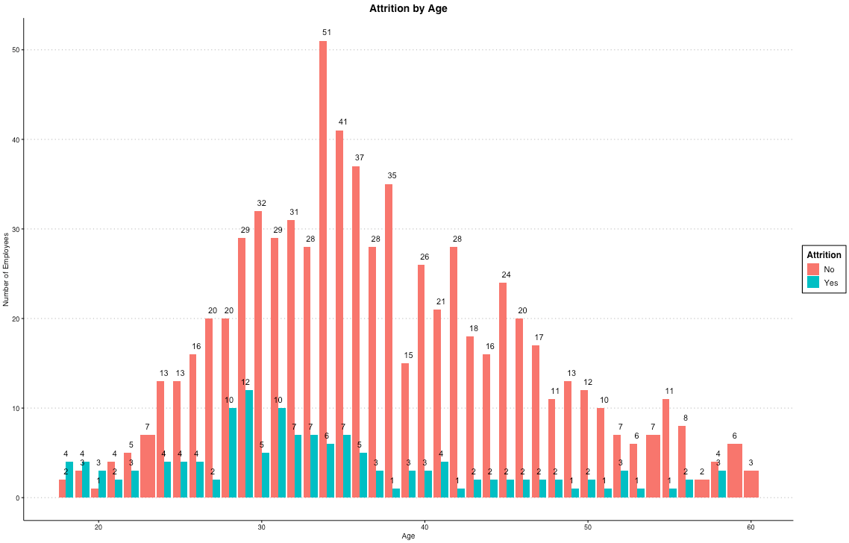
Insights and Discoveries
Examining the Data

Slide 14
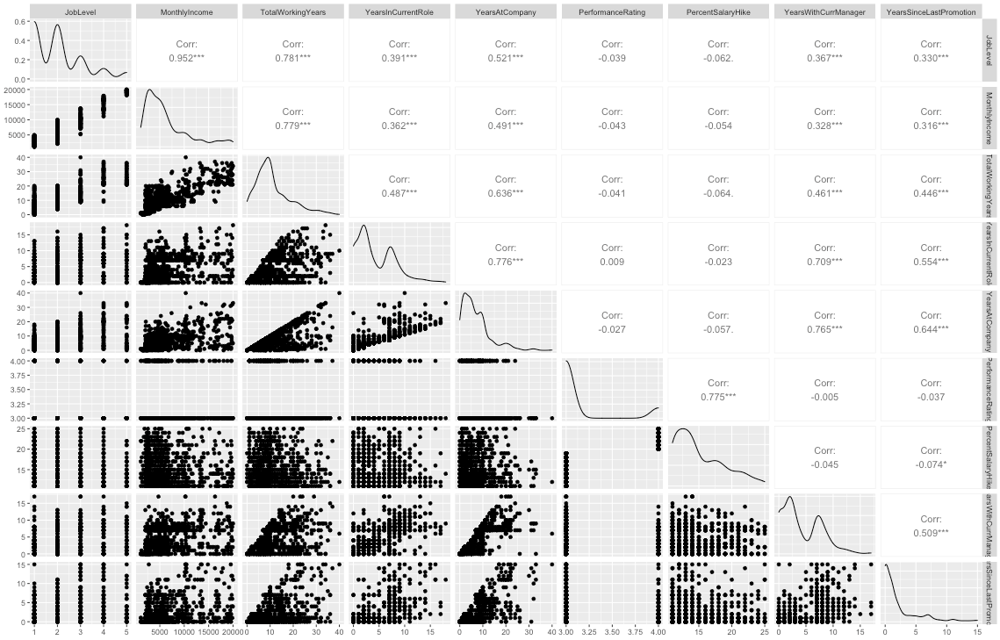
Project analysis slide 4
Insights and Discoveries
Examining the Data

Slide 15
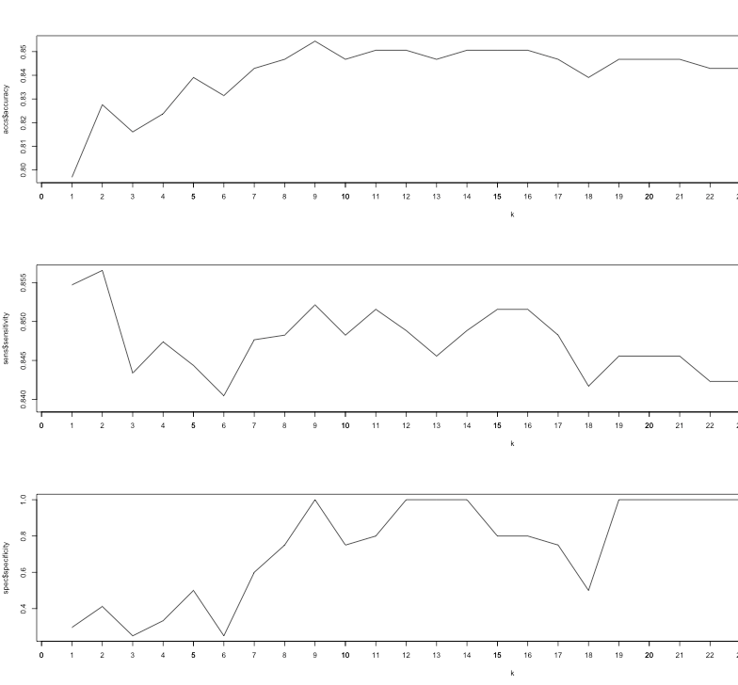
Classifying
Determining Variables and Prediction Success

Slide 16
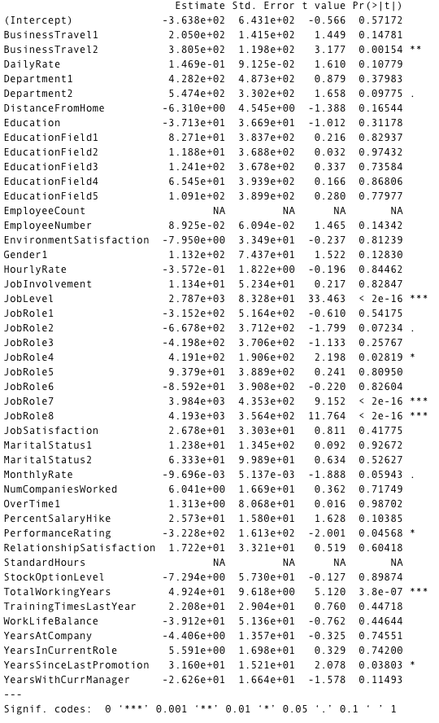
Project analysis slide 10
Modeling
Selecting Variables
Selected Variables for Model
BusinessTravel
JobLevel
JobRole
YearsSinceLastPromotion

Slide 17
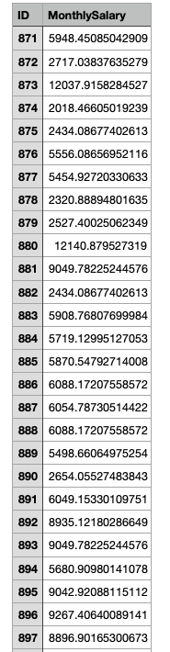
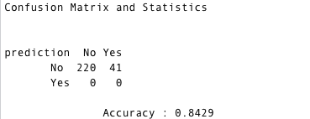
Predicting
Determining Variables and Prediction Success
Regression
kNN Classifier

Slide 18
Thank You
Please email all questions and concerns to zharris@smu.edu.

